Slide 1
Micro credit project
Submitted by :- Kaushik veer

Slide 2
contents
Introduction
Analytical Problem Framing
EDA and Visualization
Model building and evaluation
Results
Conclusion

Slide 3
INTRODUCTION
A Microfinance Institution (MFI) is an organization that offers financial services to low income populations. MFS becomes very useful when targeting especially the unbanked poor families living in remote areas with not much sources of income. The Microfinance services (MFS) provided by MFI are Group Loans, Agricultural Loans, Individual Business Loans and so on.
Many microfinance institutions (MFI), experts and donors are supporting the idea of using mobile financial services (MFS) which they feel are more convenient and efficient, and cost saving, than the traditional high-touch model used since long for the purpose of delivering microfinance services. Though, the MFI industry is primarily focusing on low income families and are very useful in such areas, the implementation of MFS has been uneven with both significant challenges and successes.
Today, microfinance is widely accepted as a poverty-reduction tool, representing $70 billion in outstanding loans and a global outreach of 200 million clients.

Slide 4
We are working with one such client that is in Telecom Industry. They are a fixed wireless telecommunications network provider. They have launched various products and have developed its business and organization based on the budget operator model, offering better products at Lower Prices to all value conscious customers through a strategy of disruptive innovation that focuses on the subscriber.
They understand the importance of communication and how it affects a person’s life, thus, focusing on providing their services and products to low income families and poor customers that can help them in the need of hour.
They are collaborating with an MFI to provide micro-credit on mobile balances to be paid back in 5 days. The Consumer is believed to be defaulter if he deviates from the path of paying back the loaned amount within the time duration of 5 days. For the loan amount of 5 (in Indonesian Rupiah), payback amount should be 6 (in Indonesian Rupiah), while, for the loan amount of 10 (in Indonesian Rupiah), the payback amount should be 12 (in Indonesian Rupiah).

Slide 5
Analytical Problem Framing
The sample data is provided to us from our client database. It is hereby given to us for this exercise. In order to improve the selection of customers for the credit, the client wants some predictions that could help them in further investment and improvement in selection of customers.
Exercise:
Build a model which can be used to predict in terms of a probability for each loan transaction, whether the customer will be paying back the loaned amount within 5 days of insurance of loan. In this case, Label ‘1’ indicates that the loan has been payed i.e. Non- defaulter, while, Label ‘0’ indicates that the loan has not been payed i.e. defaulter.
Points to Remember:
There are no null values in the dataset.
There may be some customers with no loan history.

Slide 6
The dataset is imbalanced. Label ‘1’ has approximately 87.5% records, while, label ‘0’ has approximately 12.5% records.
For some features, there may be values which might not be realistic. You may have to observe them and treat them with a suitable explanation.
You might come across outliers in some features which you need to handle as per your understanding. Keep in mind that data is expensive and we cannot lose more than 7-8% of the data.
Find Enclosed the Data Description File and The Sample Data for the Modeling Exercise.

Slide 7
EDA and Visualization
Number of rows and columns in the dataset are rows =209593 and columns are 37
There are no null values present in the data.
All the variables are in numerical form except for msisdn and pcircle
misdn represents mobile numbers of users and that are unique all the time pcircle same output for all the columns so we can drop pcircle and msisdn as well as unnamed as it is of no use for model building

Slide 8
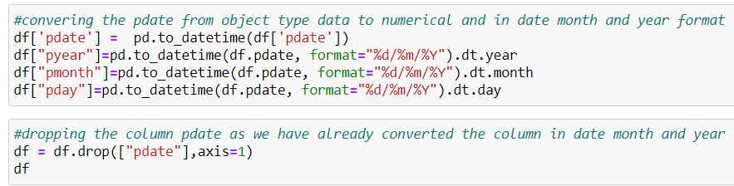
We converted pdate into numerical form by converting the data into day-month and year and dropping the column pdate as it was of no use then.
We checked value counts for all the variables and we found that pyear has only one data so we can drop the columns as we already have month and day to define the entry
columns like fr_da_rech90, medianamnt_loans30, medianamnt_loans90,last_rech_date_da,cnt_da_rech30,fr_da_rech30,cnt_da_rech90,maxamnt_loans30, maxamnt_loans90 are showing biasing in their data as you can see in the value counts.

Slide 9
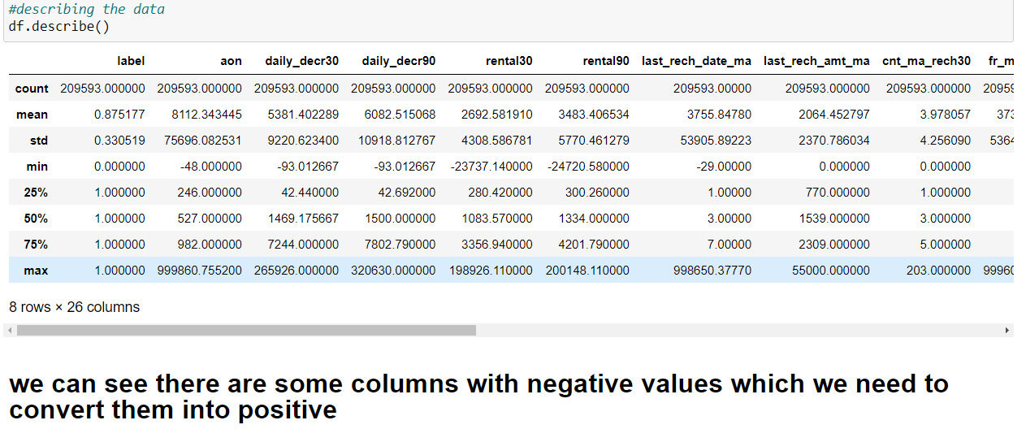
Hence we can drop the above mentioned columns
We saw some negative values so we converted them into positive values using abs function.

Slide 10
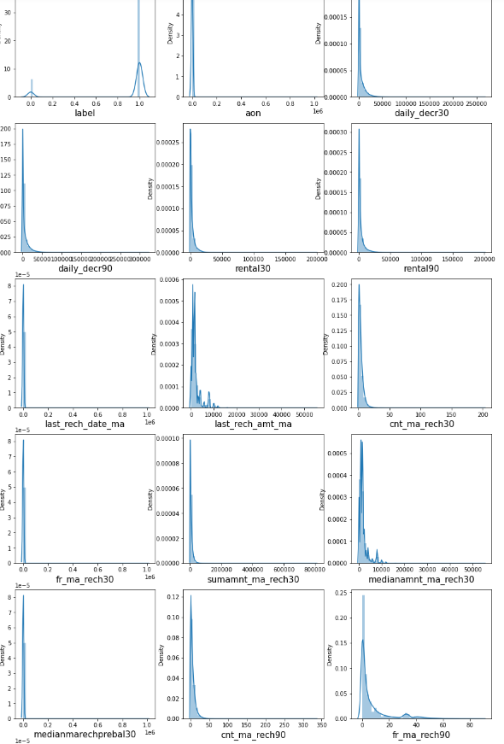
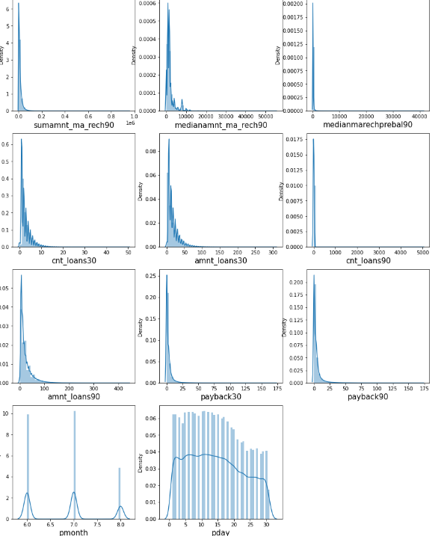

Slide 11
Observation from the above graphs
there is skewness in most of the columns so we have to treat them.
pmonth and pday shows biomodal distribution

Slide 12
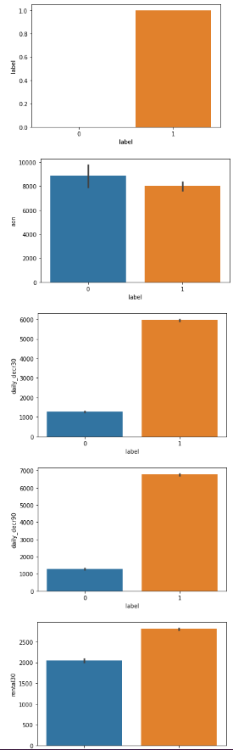
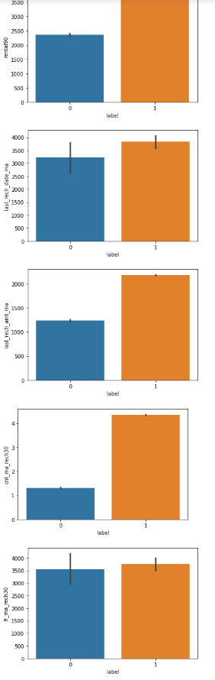
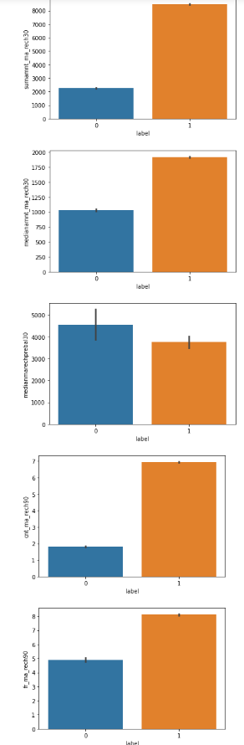
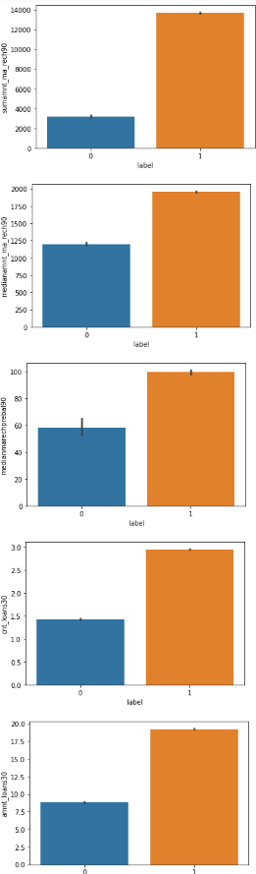
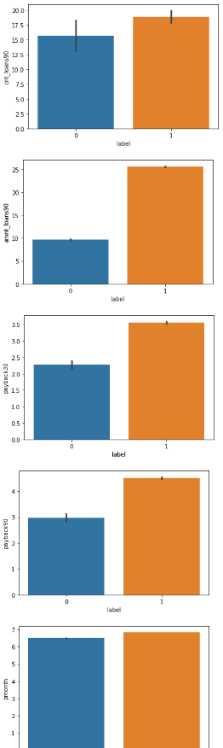
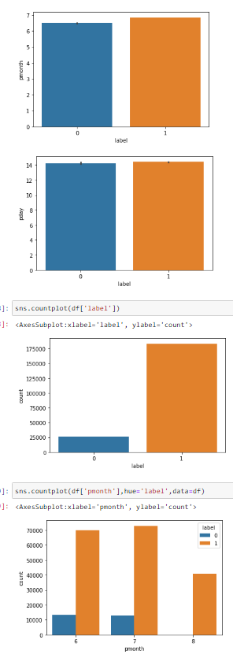

Slide 13
Observation from the above graphs
People with longer duration of network usage are maximum defaulters
People with higher Median of main account balance just before recharge in last 30 days at user level are maximum defaulters
people with majority of Daily amount spent from main account, averaged over last 30 days (daily_decr30) are most likely to pay their loan.
people with majority of Daily amount spent from main account, averaged over last 90 days(daily_decr90) are most likely to pay their loan.
people with majority of Average main account balance over last 30 days(rental30) are most likely to pay their loan.
people with majority of Average main account balance over last 90 days(rental90) are most likely to pay their loan.

Slide 14
people with majority of days till last recharge of main account(last_rech_date_ma) are most likely to pay their loan.
people with majority of Amount of last recharge of main account (last_rech_amt_ma) are most likely to pay their loan.
people with majority of Number of times main account got recharged in last 30 days(cnt_ma_rech30) are most likely to pay their loan.
people with majority of Frequency of main account recharged in last 30 days(fr_ma_rech30) are are most likely to pay their loan and also the count is high for defaulters comparitively Non-defaulters are more in number.
people with majority of Total amount of recharge in main account over last 30 days (sumamnt_ma_rech30) are most likely to pay their loan.
people with majority of Median of amount of recharges done in main account over last 30 days at user level (medianamnt_ma_rech30) are most likely to pay their loan.
people with majority of Median of main account balance just before recharge in last 30 days at user level (medianmarechprebal30) are most likely to pay their loan.
people with majority of Number of times main account got recharged in last 90 days(cnt_ma_rech90) are most likely to pay their loan.
people with majority of Frequency of main account recharged in last 90 days(fr_ma_rech90) are most likely to pay their loan.

Slide 15
people with majority of Total amount of recharge in main account over last 90 days (sumamnt_ma_rech90) are most likely to pay their loan.
people with majority of Median of amount of recharges done in main account over last 90 days at user level (medianamnt_ma_rech90) are most likely to pay their loan.
people with majority of Median of main account balance just before recharge in last 90 days at user level (medianmarechprebal90) are most likely to pay their loan.
people with majority of Number of loans taken by user in last 30 days(cnt_loans30) are most likely to pay their loan.
people with majority of Total amount of loans taken by user in last 30 days(amnt_loans30) are most likely to pay their loan.
people with majority of maximum amount of loan taken by the user in last 30 days(maxamnt_loans30) are most likely to pay their loan.

Slide 16
people with majority of Number of loans taken by user in last 90 days(cnt_loans90) are most likely to pay their loan.
people with majority of Total amount of loans taken by user in last 90 days(amnt_loans90) are most likely to pay their loan.
people with majority of maximum amount of loan taken by the user in last 90 days(maxamnt_loans90) are most likely to pay their loan.
people with majority of Average payback time in days over last 30 days(payback30) are most likely to pay their loan.
people with majority of Average payback time in days over last 90 days(payback90) are most likely to pay their loan.
People having pmonth 8 have always payed back their loan

Slide 17
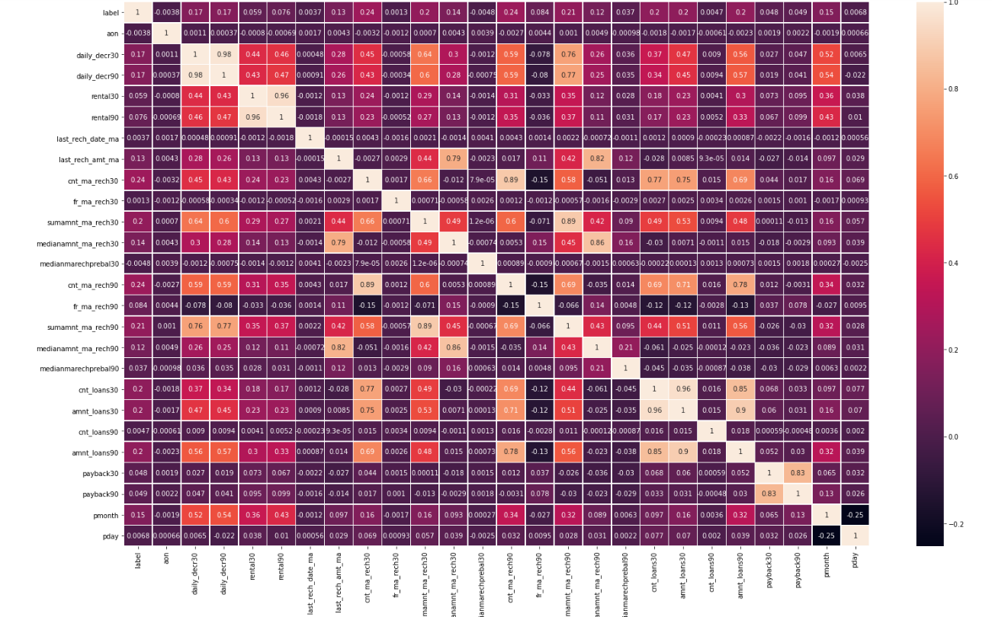

Slide 18
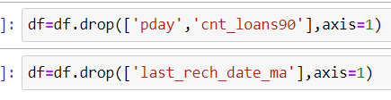
Observation from the above correlation heatmap
pday, cnt_loans90, medianmarechprebal90, medianmarechprebal30, fr_ma_rech30, aon have very less correlation with the label
cnt_ma_rech30, cnt_ma_rech90, sumamnt_ma_rech30 are some of the columns highest correlation with label
we decide to drop pday and cnt_loans90, last_rech_date_ma as they have the lowest correlation with output variable

Slide 19
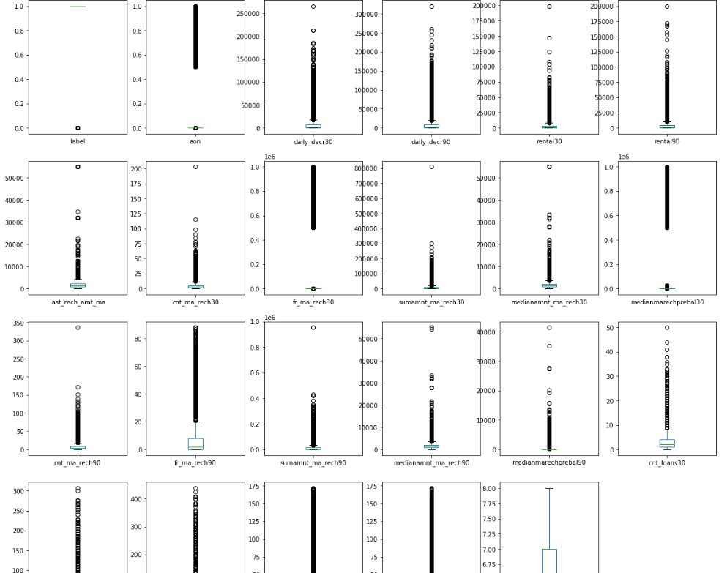
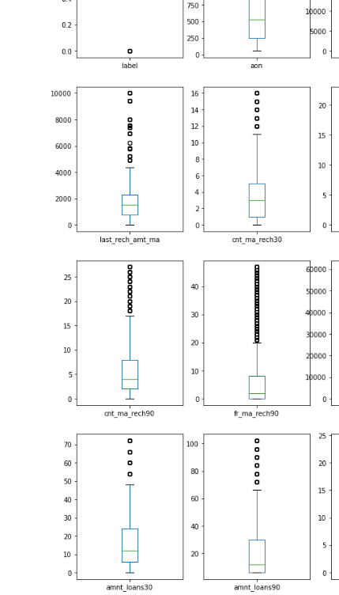

Slide 20
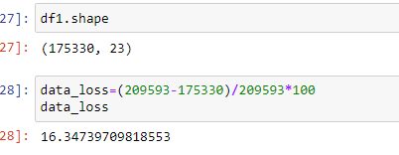
Outliers are present in almost all the columns except for pmonth
We used zscore method to remove the outliers but data loss was around 16% which I can’t afford to lose.
We used quantile method to remove the outliers and we were able to remove outiers to some extent with minimum data loss.

Slide 21
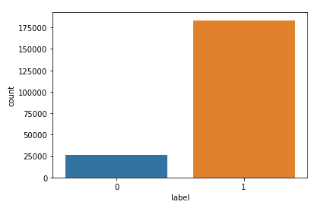
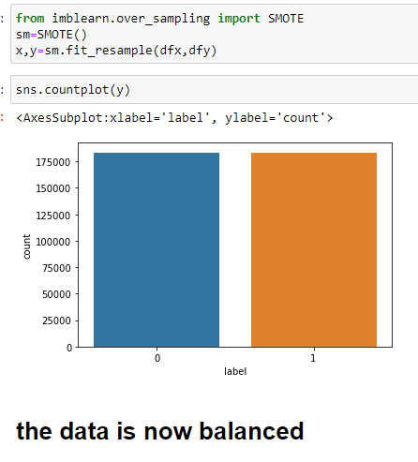
The data was not balanced with reference to label
We need to balance the data so we used SMOTE
Using the somte method to balance the data and we can see that the data is perfectly balanced

Slide 22
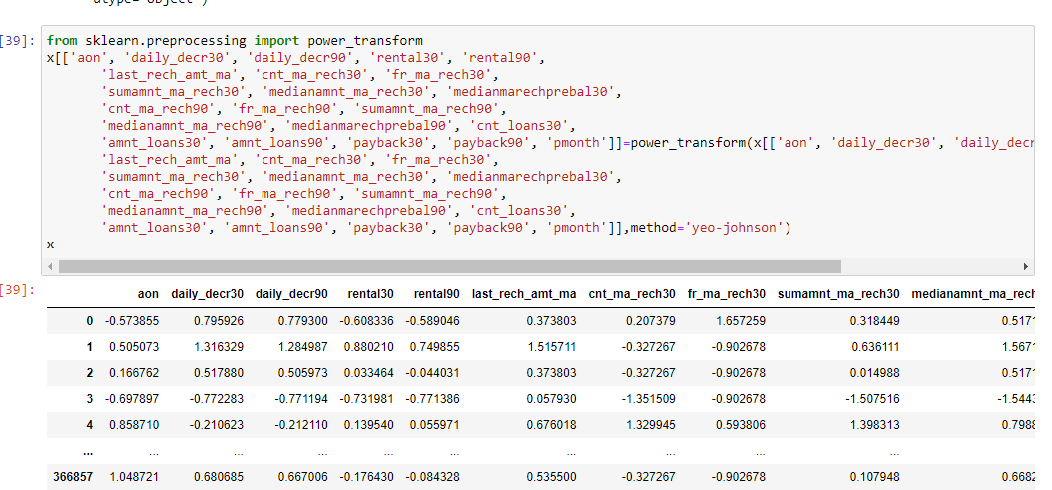
We used power transform method to remove the skewness from the data
aftter all the EDA, Cleansing, scaling and balancing we can move forward to build models

Slide 23
MODEL BUILDING
We used models like :-
1) logistic regression
2) DecisionTreeClassifier
3) ExtraTreesClassifiers
4) SGDClassifier
Below are the images of our models performance

Slide 24
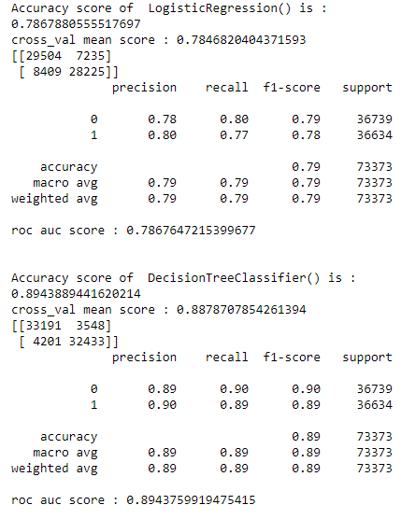
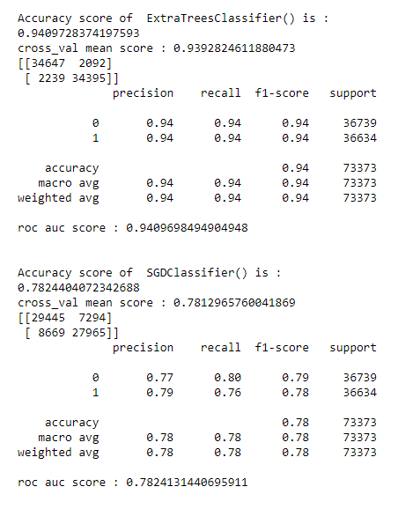

Slide 25
In the above images we saw our models performance.
We split the data into into X and Y where x hold all the input variables after performing all the EDA and cleansing of data and Y holds the output variable which is a label.
Our output variable is categorical nature so it’s a classification problem for which we used classification models to predict values.
We used train test split to split the data and perform machine learning tasks.
We used train_test_split to split the data into xtrain,xtest and ytrain,ytest with test size set to 0.20 which is 20% of the data set. It means that ytest and xtest will hold 20% of the random data which the model will use for testing purpose and predict the data for the xtest and chech how accurate it is with ytest.
We included cross val score and cv set to 5 and checking the mean score. Random state is set to 45, we will be checking the roc_auc score for accuracy results.

Slide 26
RESULTS
we checked the accuracy score, roc-auc score as well the mean cross val score with cv set to 5 what we observed is that:-
logistic regression gave us close to 79% accuracy
decision tree gave us close to 90% accuracy
extratreesclassifier is giving us a very high accuracy with close to 95% accuracy and it is the highest among others
We used hyper parameter tuning on the extratrees to improve our best models performance.

Slide 27
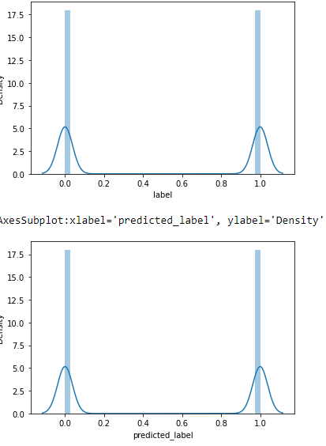
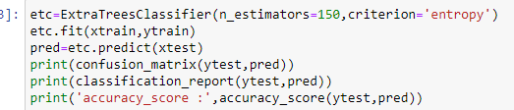
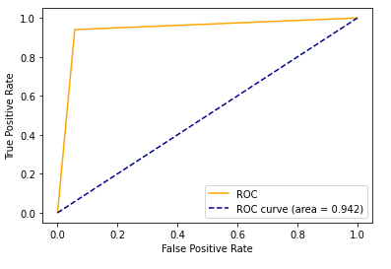
After hypertuning we checked the roc-auc curve to check the results
We also used distplot to plot predicted values and actual values to
see the difference.

Slide 28
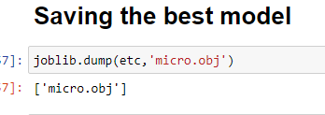
we can see that the predicted values and the actual values are highly similar to each other
our model Extra trees is working very good with accuracy of 95% on trained data and 99% on test data
We will be saving our best model to predict the data for this dataset.

Slide 29
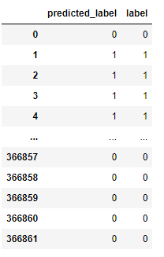
conclusion
We had to perform analysis on the train data and clean the data and build a model which will predict the house prices for the test data.
We did some visualization and pre-processing and after scaling the data we were able to build a model with close to 95% accuracy.
We used the model to predict label value for the test data. Here is the image of the results:-

Slide 30
We found the important features and how do they affect positively and negatively with label values of the micro credict loans and used them to predict the defaulters and non defaulters list using machine learning models.
I learned that using data science it can help the business to make better strategies and focus on the areas which affects the output variables and make better decisions.

